Slide 1
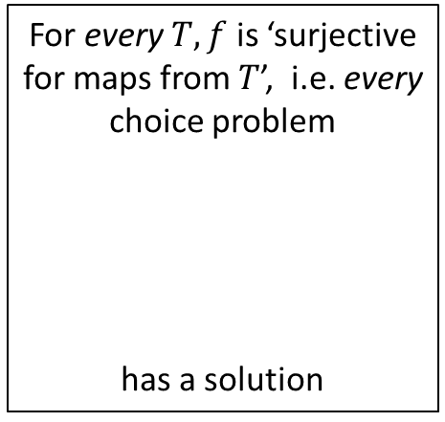









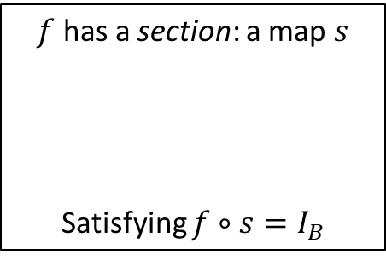
















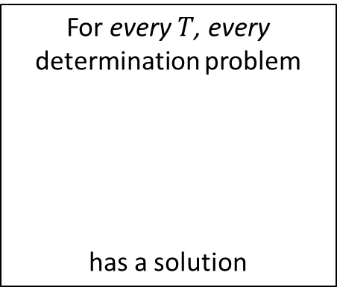









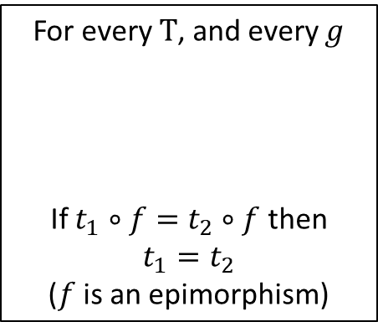
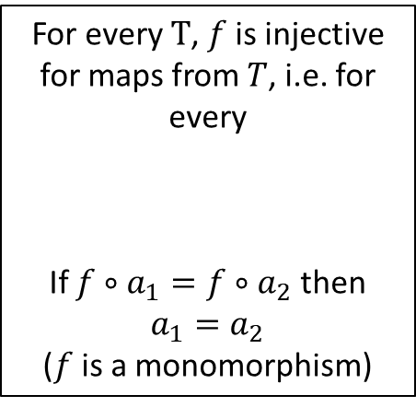







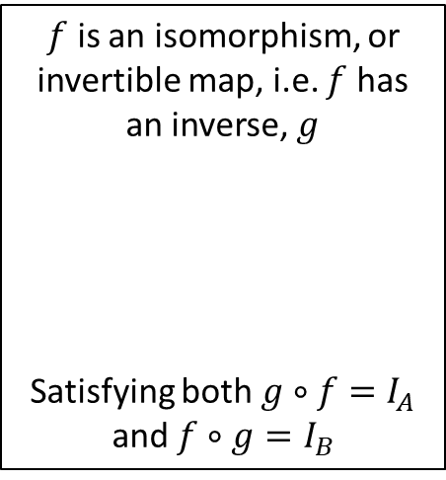

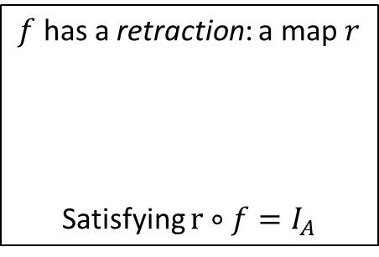


$f$ has a section: a map $s$
Satisfying $f∘s=I_{B}$
For every $T$, and every $g$
If $t_{1}∘f=t_{2}∘f$ then $t_{1}=t_{2}$
($f$ is an epimorphism)
$$s$$
$f$ has a retraction: a map $r$
Satisfying $r∘f=I_{A}$
$$t_{1}$$
$$r$$
$$B$$
$$T$$
$$A$$
$$B$$
$$t_{2}$$
$$f$$
$$A$$
$$B$$
$f$ is an isomorphism, or invertible map, i.e. $f$ has an inverse, $g$
Satisfying both $g∘f=I_{A}$ and $f∘g=I_{B}$
$$f$$
or
The choice problem
has a solution
or
$$g$$
$$A$$
The determination problem
has a solution
$$f$$
$$B$$
$$s?$$
$$r?$$
$$f$$
$$A$$
$$B$$
$$B$$
$$B$$
$$f$$
$$I_{B}$$
$$A$$
$$A$$
For every $T$, $f$ is injective for maps from $T$, i.e. for every
If $f∘a_{1}=f∘a_{2}$ then $a_{1}=a_{2}$
($f$ is a monomorphism)
$$I_{A}$$
or
For every $T, f$ is ‘surjective for maps from $T$’, i.e. every choice problem
has a solution
or
$$a_{1}$$
For every $T$, every determination problem
has a solution
$$T$$
$$A$$
$$B$$
$$a_{2}$$
$$A$$
$$?$$
$$f$$
$$f$$
$$?$$
$$A$$
$$T$$
$$T$$
$$B$$
$$t$$
$$b$$

Slide 2
Father
feather
stone
Mother
Child
flower
Park
off
get in
lock the door
Neutral
on
Reverse
get out
unlock the door
Drive
A
f
Andy
g
Barbara
B
A
B
C
Carl
D
Denise
E
g

